Slide 1


Wingman Influencer
Trendsetters Technologies

Slide 2
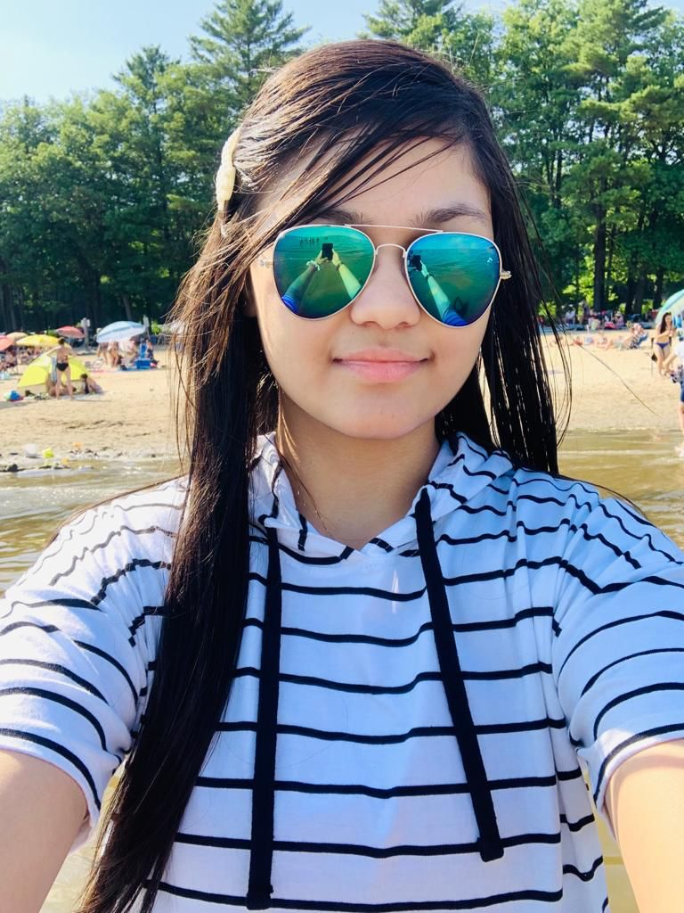
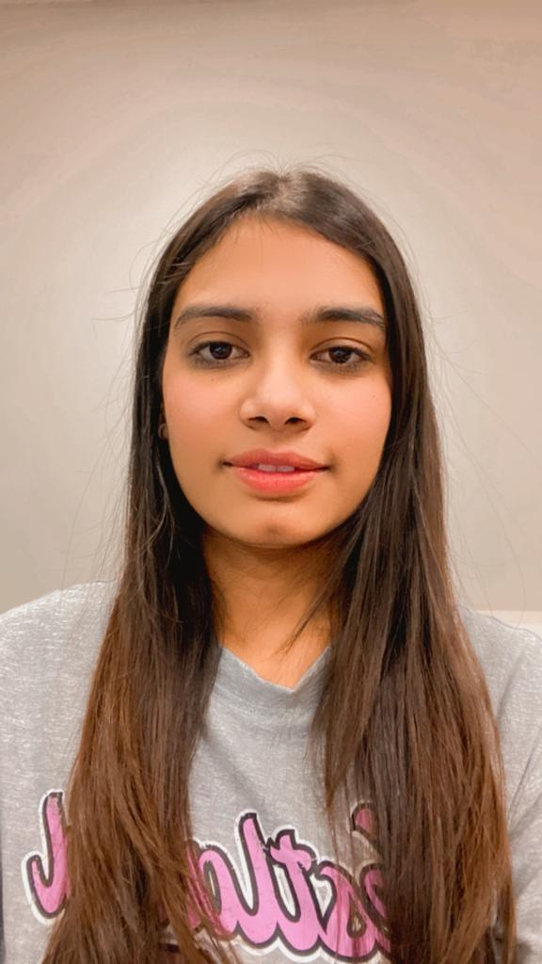
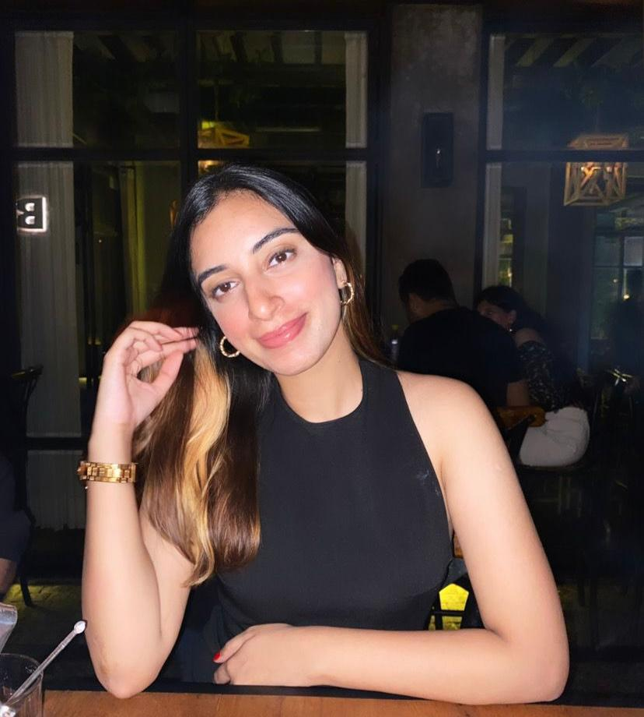
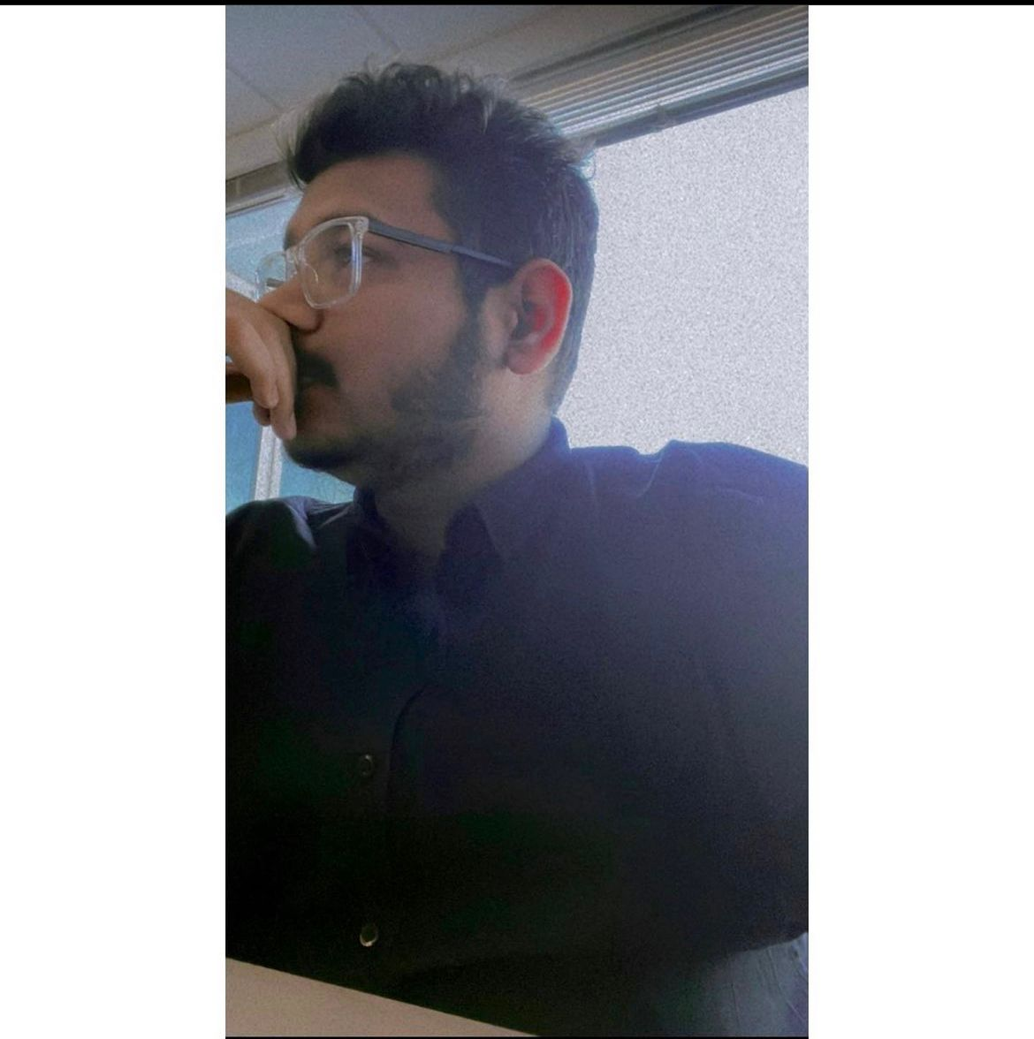
Our Team
Somya Tyagi
Malav Desai
Prachi Prachi
Jashanpreet kaur
Product Owner
Development Team
Scrum Master
Development Team

Slide 3
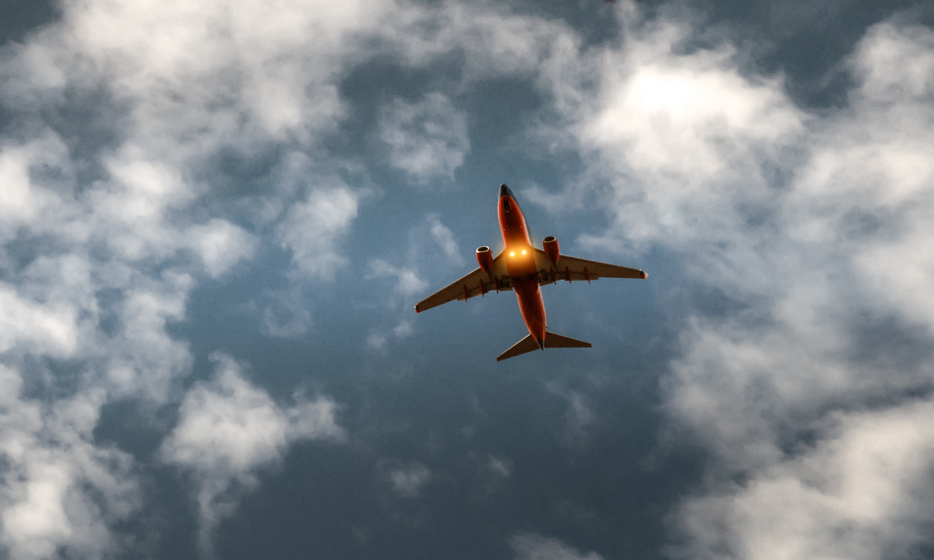
VISON
AN ECOSYSTEM FOR SOCIAL
MEDIA INFLUNCERS &
BRANDS
About

Slide 4

PROBLEM
Problem
Market Gap
MEASURABILITY
Traditional marketing is very costly and small or medium scale business can't afford it
It's very difficult to track profits and ROI through traditional marketing.
WASTAGE
EFFECTIVENESS
Although paper hoardings, banners and newspapers print are great and does the job perfectly, there is a slight problem. We are running out of trees.
Google found out more than 56% of traditional advertisements are never seen by consumers and they can never target the right audience.

Slide 5
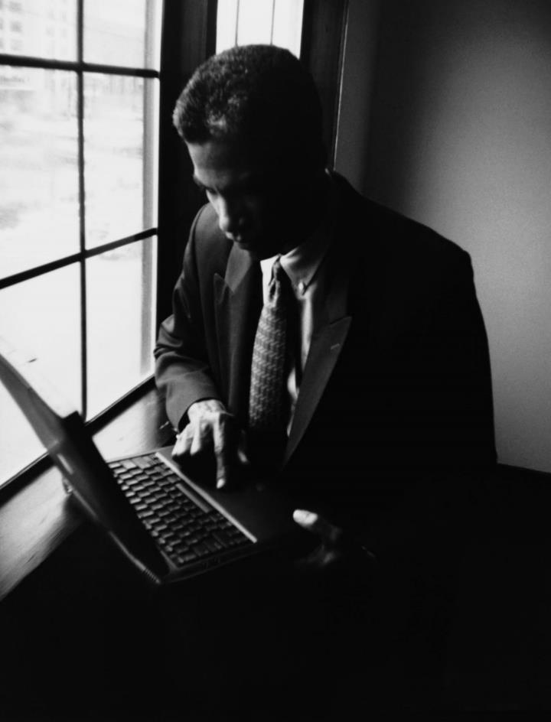
SOLUTION
CLOSE THE GAP
Influencer marketing is so affordable that any business be it small, medium or large scale all can afford it.
TARGET AUDIENCE
Influencer marketing helps reach your target audience by selecting the right influencers by checking their engagement analysis.
MEASURABILITY
Profits and ROI can easily be measured in influencer marketing through affiliate links, coupon codes, trackable links.
ENVIRONMENT FRIENDLY ( DIGITAL PLATFORM )
There is zero advertising wastage as there is no banners or hoarding because everything is digital.

Slide 6

PRODUCT OVERVIEW
WHO WE ARE ?
- Every influencer and every brand has a place on our platform. .
- Wingman influencers eliminates middle man from the process and directly connects the influencers and the brands.
- Brands can reach their target audience by viewing the engagement ratio of the influencers through our inbuild feature in the app.
- We are the first Influencer Marketing Platform introducing Barter Collaborations.

Slide 7

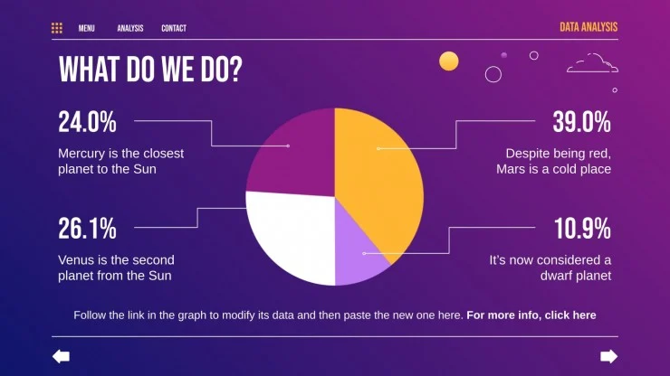

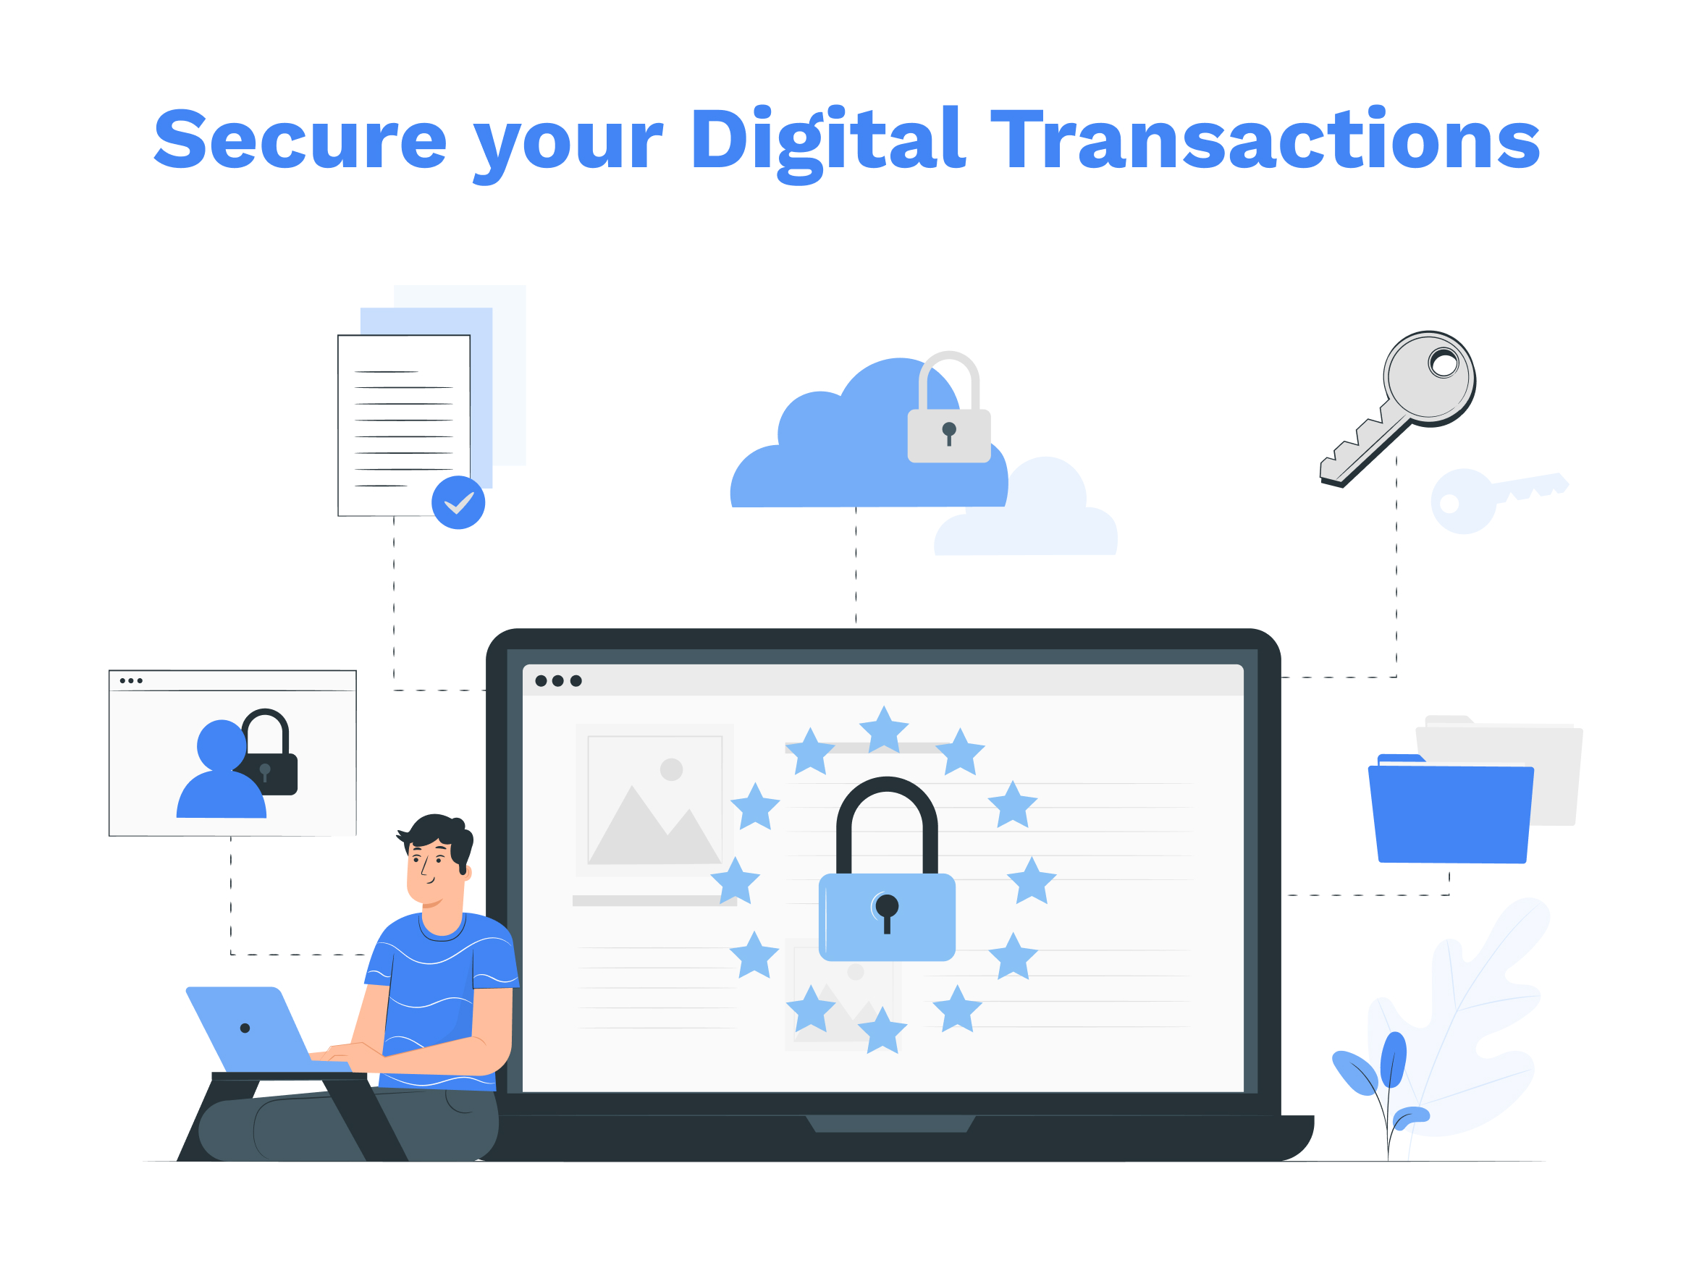
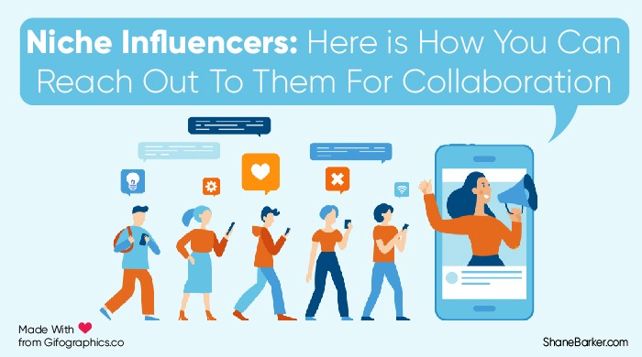
FEATURES/USP
CAMPAIGN REPORT ANALYSIS
15 DAYS TIME BOUND PROJECTS
INTRODUCING BERTER COLLABORATION
SAFE AND SECURE TRANSACTIONS

Slide 8
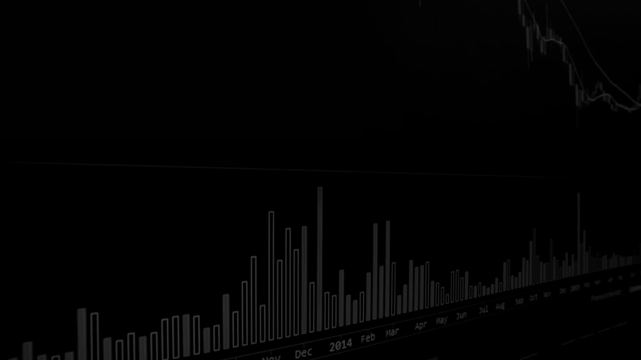
PROFITS PROJECTION
50$
100$
BLOGGERS
MONTHLY SUBSCRIPTION WITH 7 DAYS FREE TRIAL PERIOD.
BRAND
MONTHLY SUBSCRIPTION WITH 7 DAYS TRIAL PERIOD

Slide 9
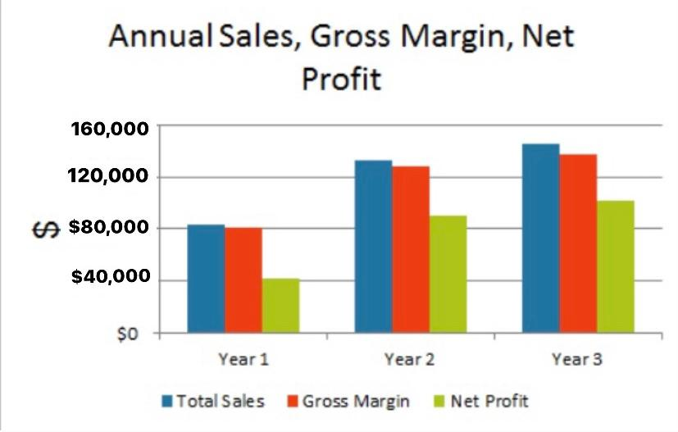
PROFITS PROJECTION GRAPH

Slide 10
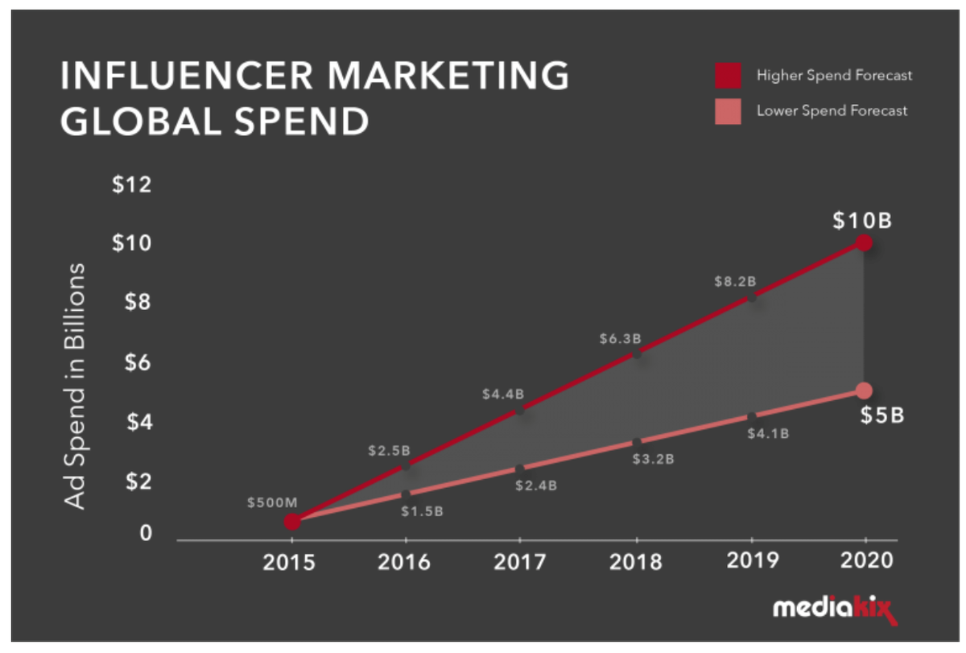
INFLUENCER MARKETING IN 2022 AND BEYOND
63% OF MARKETERS INTEND TO INCREASE THEIR INFLUENCER MARKETING BUGET IN THE NEXT YEAR (JUST 5% INTEND TO DECREASE IT).
- BY 2023, BRANDS WILL BE SPENDING $4.62 BILLION PER YEAR ON INFLUENCER MARKETING

Slide 11

OUR COMPETITION
COMPETITORS
Neo Reach worked with brands like FanDuel, World of Tanks, Walmart, and FIFA
Carusele Pepsi, Hallmark, Walgreens, and Sabra.
The Influencer Agency
They also have one of the largest databases of influencers, with access to over 3,000 influencers across the globe.

Slide 12
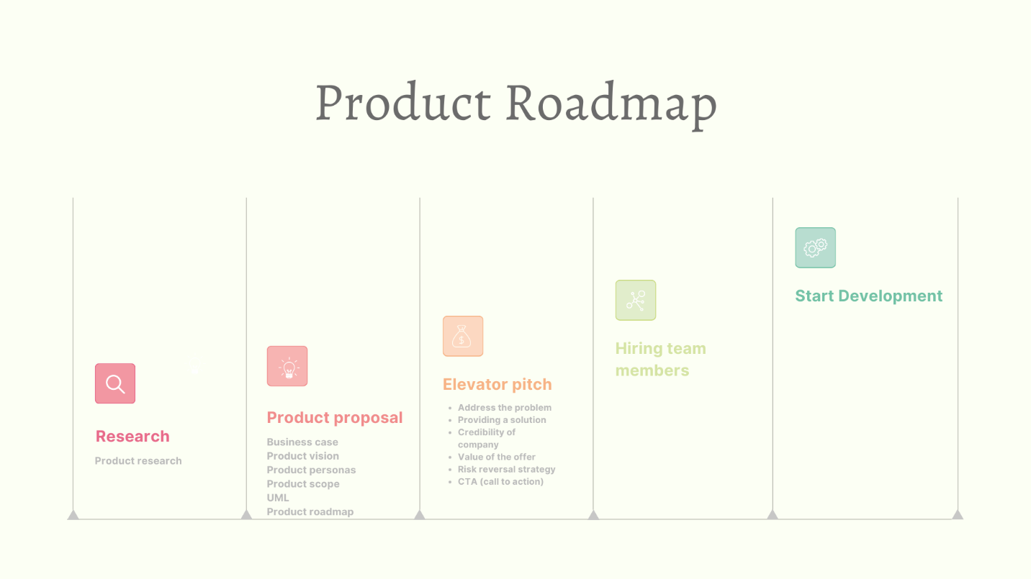

Slide 13
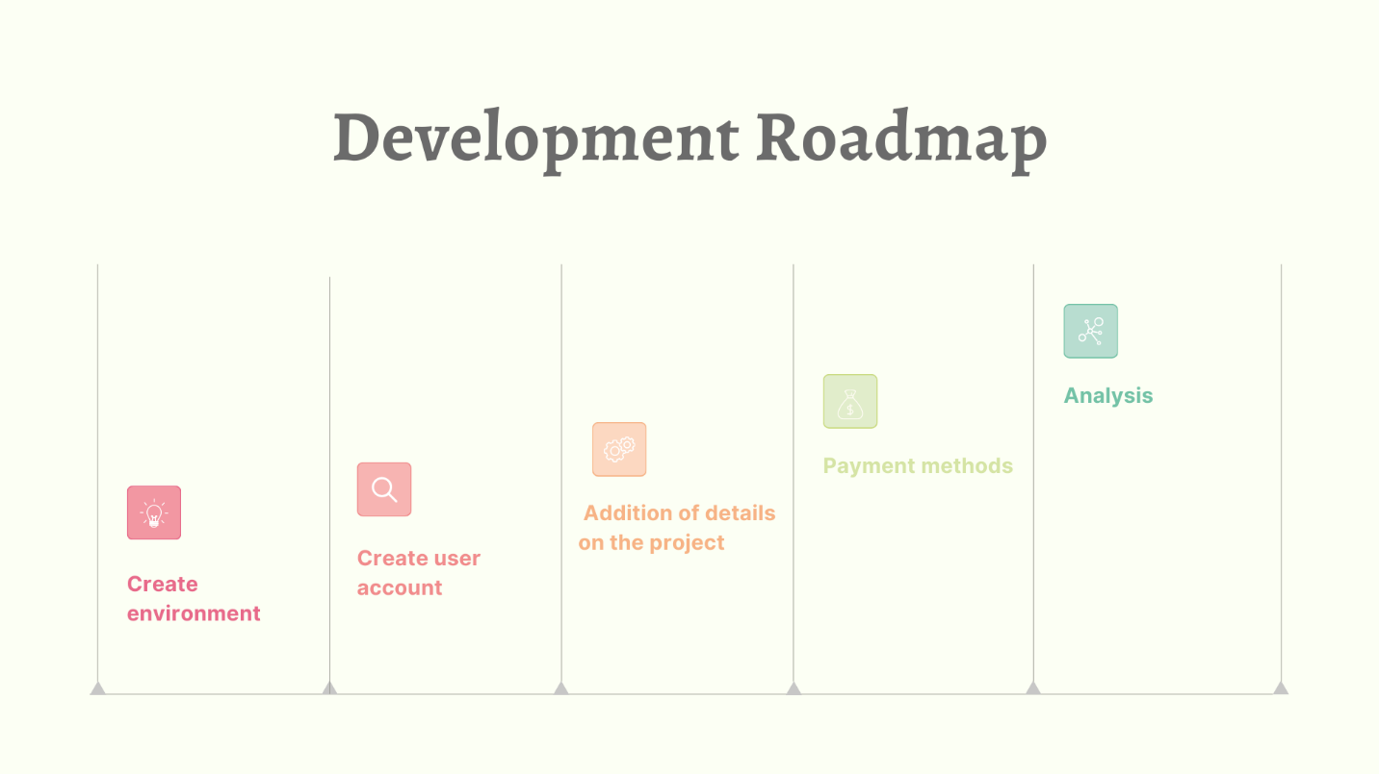

Slide 14

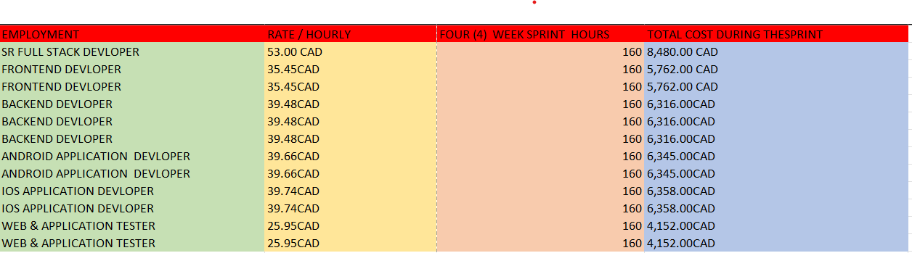
Estimation on team members to be hired

Slide 15
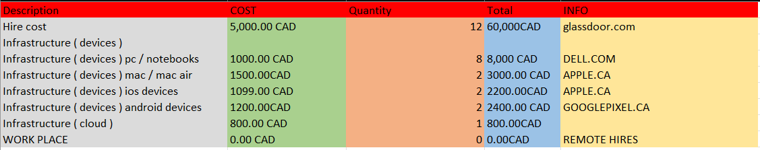
Initial Investment:
76,400 – 80,000 CAD
Monthly Investment during the development:
Monthly Fixed Expenses - 72,000.00 CAD

Slide 16
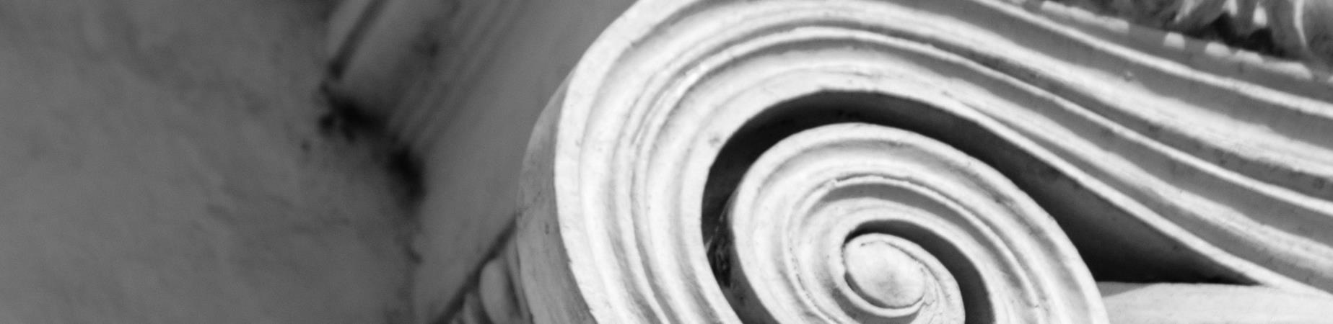
SUMMARY
At wingman Influencers, we believe in giving 110%. By closing the loop on investment management and using the latest technology, we help businesses grow and expand their social media presence. We thrive because of our market knowledge and a great team behind our product.
summary

Slide 17

Thank You
SOMYA TYAGI
MALAV DESAI
PRACHI PRACHI
JASHANPREET KAUR

